Slide 1
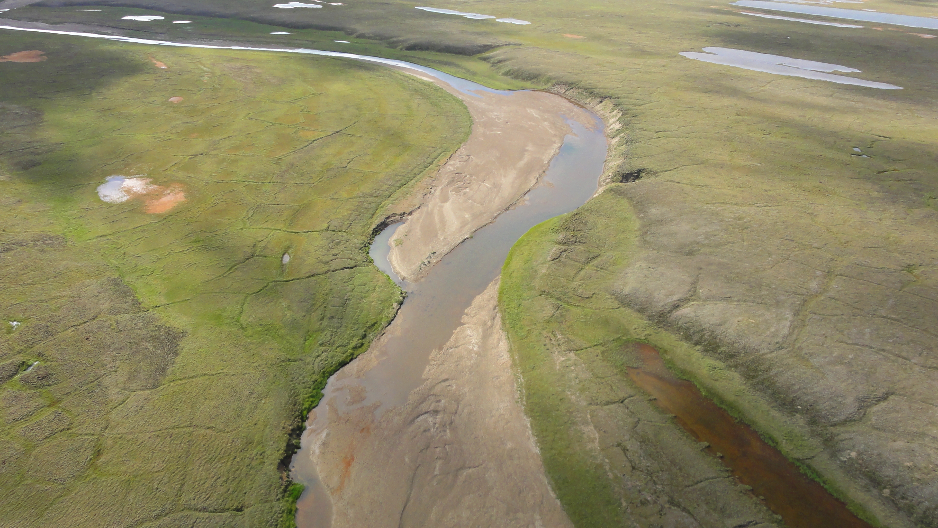

Off-Road Travel Management on Alaska’s North Slope
Alaska Department of Natural Resources
Division of Mining, Land and Water
Melissa Head, Northern Oil & Gas Team Manager

Slide 2
AS 38.05.035(a)
(2) manage, inspect, and control state land and improvements on it belonging to the state and under the jurisdiction of the division;
(7) have jurisdiction over state land…to this end, the director possesses the powers and, with the approval of the commissioner, shall perform the duties necessary to protect the state's rights and interest in state land, including the taking of all necessary action to protect and enforce the state's contractual or other property rights;
Notes:
Powers and Duties of the Director

Slide 3
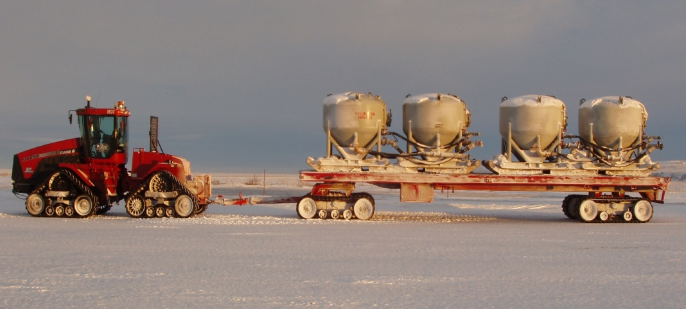
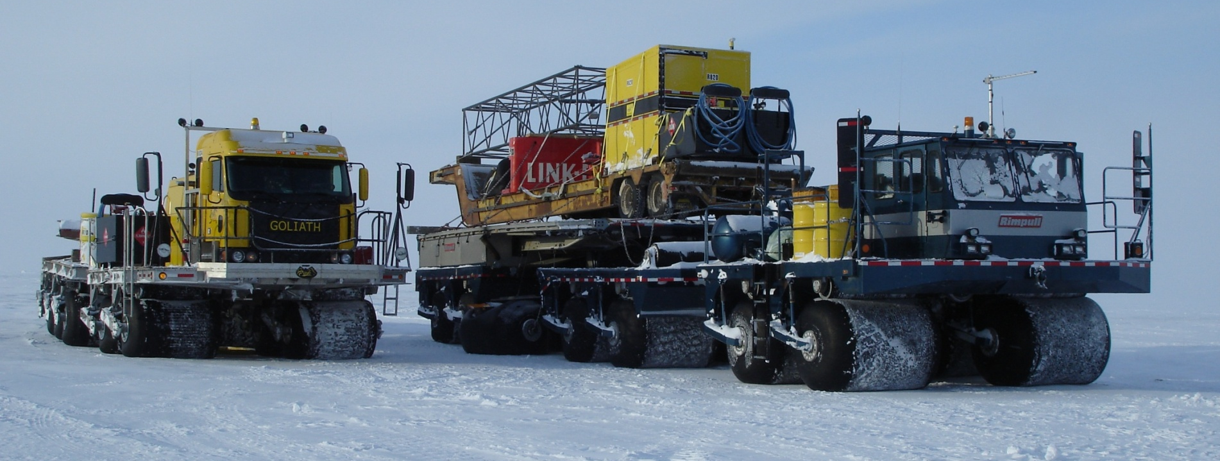
STEIGER and TRAILER
ROLLIGON

Slide 4
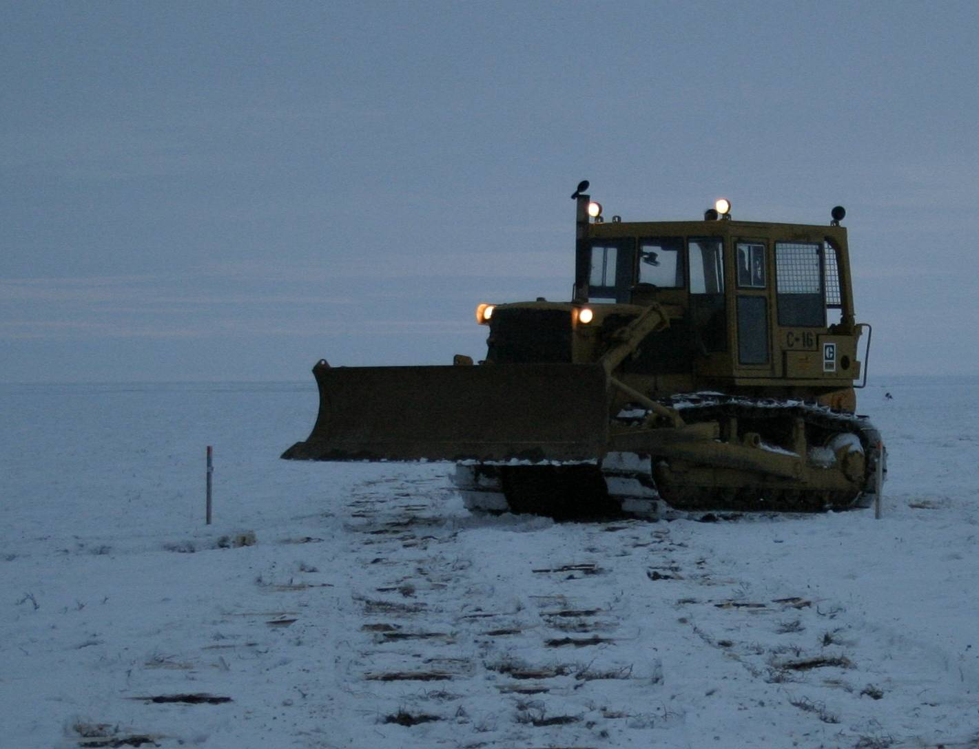
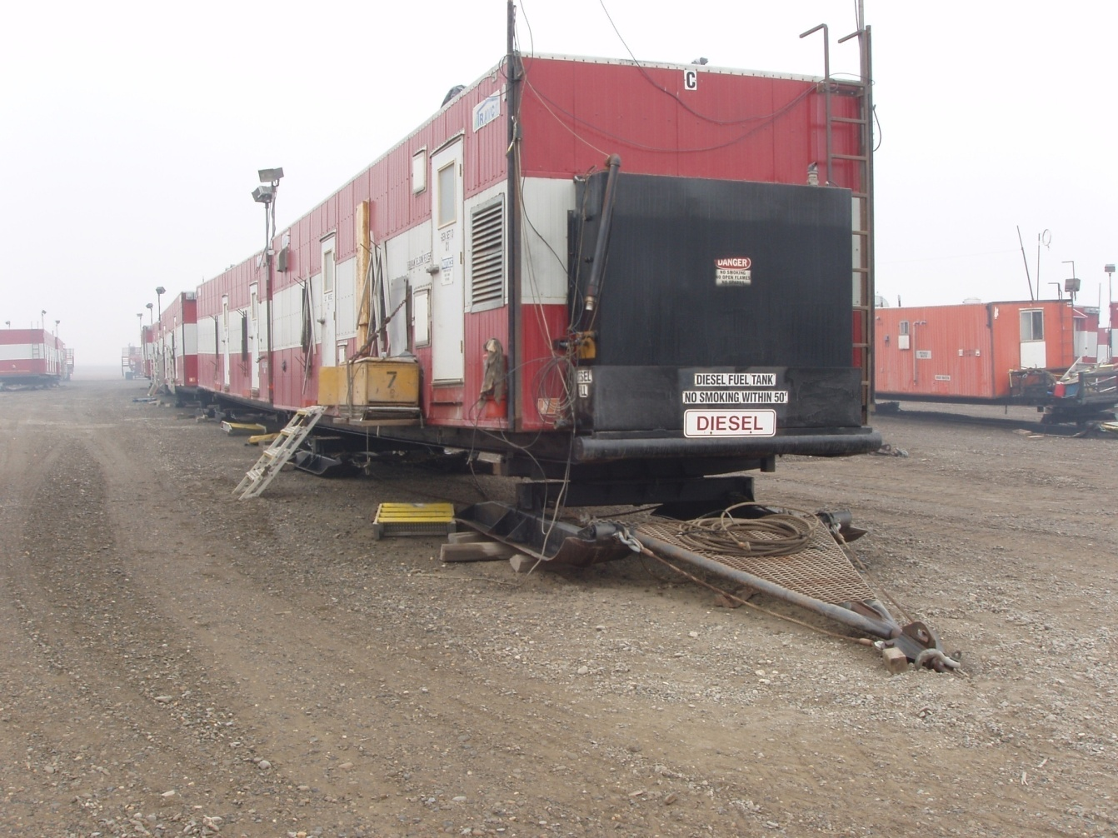
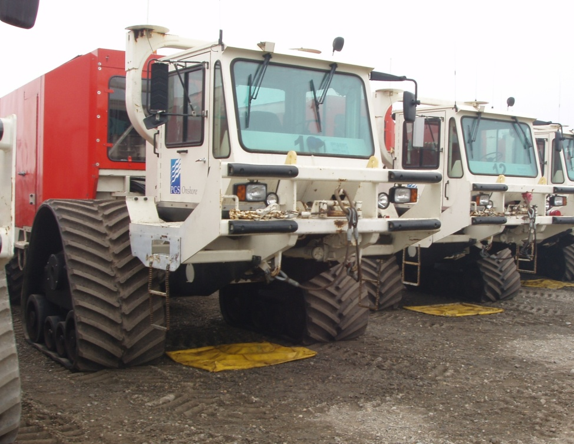
D-7 TRACTOR
SLED-MOUNTED CAMP
SEISMIC
VIBRATORS

Slide 5
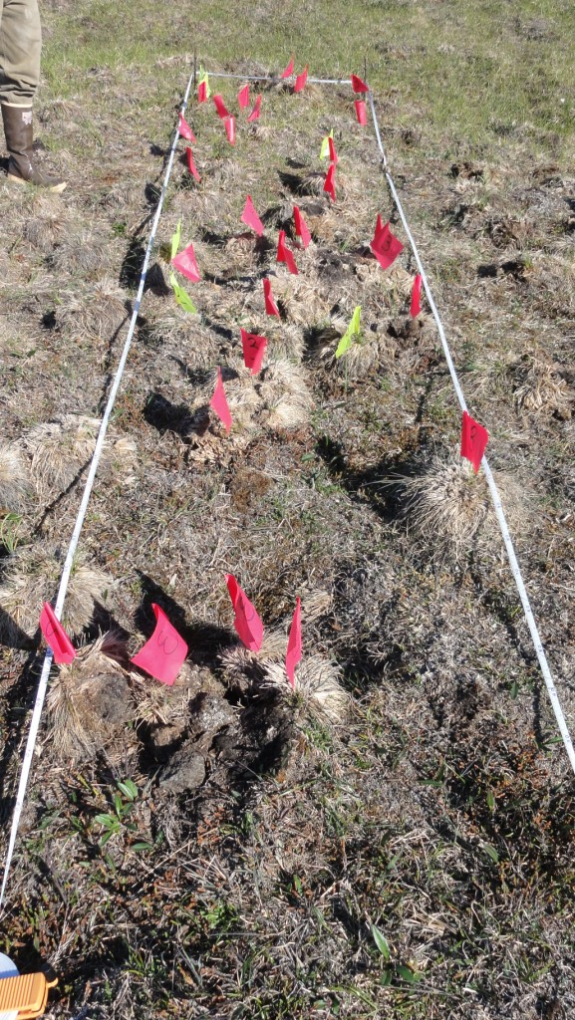
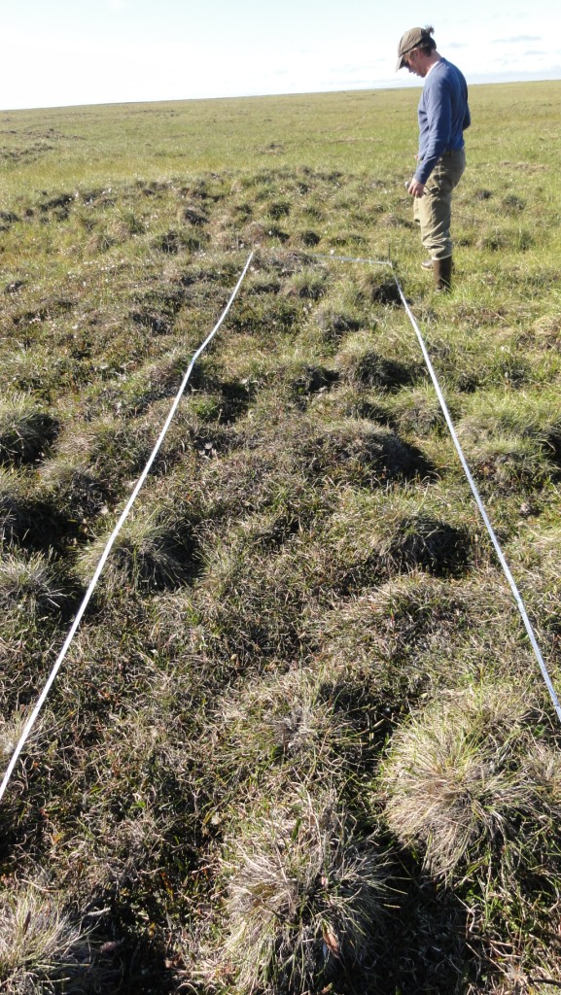
What we want to avoid: TUNDRA DAMAGE
On Ice Road
Off Ice Road
Notes:
Example from an ice road constructed during the winter of 2010/2011. High snow year. So much snow, many companies tried to remove snow from within their routes in order to allow for better water penetration to the tundra surface.

Slide 6
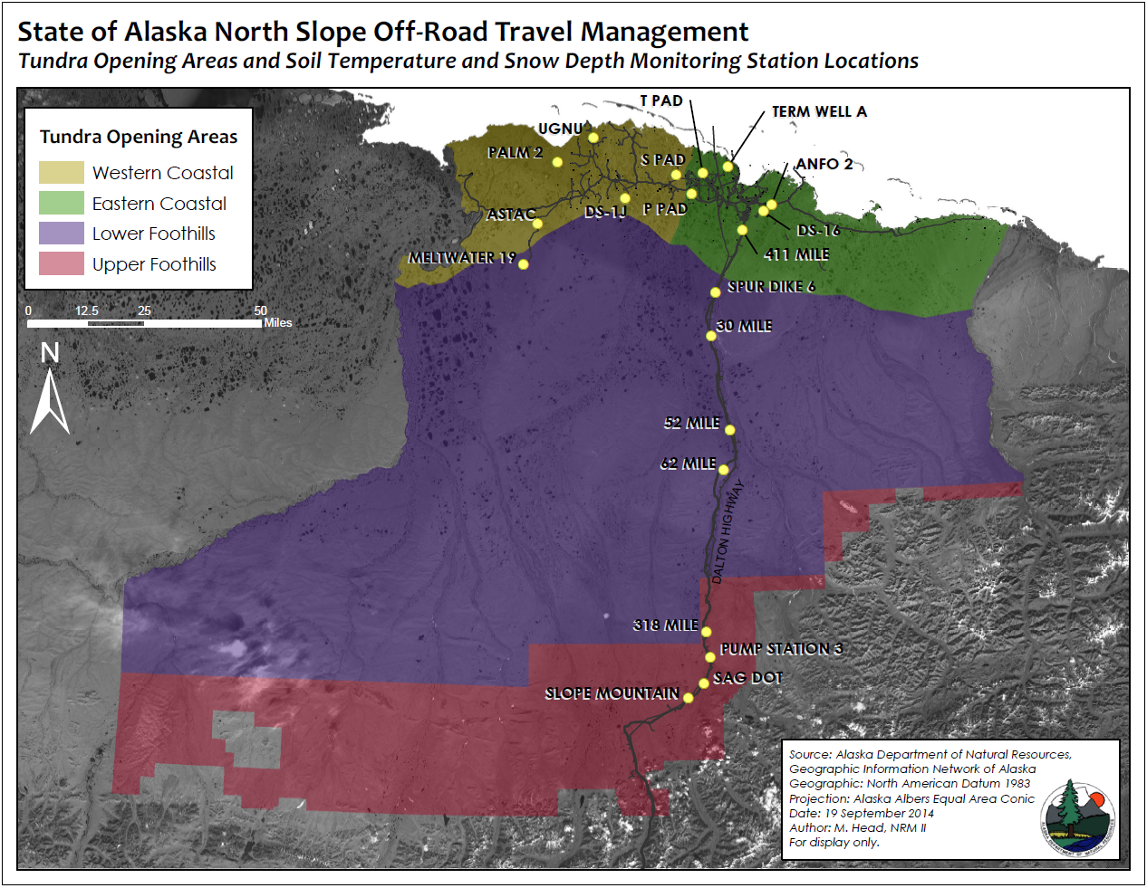

Slide 7
Off-Road Travel
Winter
Soil temperatures and snow depths must meet criteria
Any vehicle
Spring
No off-road travel from close of winter travel season until July 15
Summer
Only approved vehicles
Payloads limited to testing weight

Slide 8
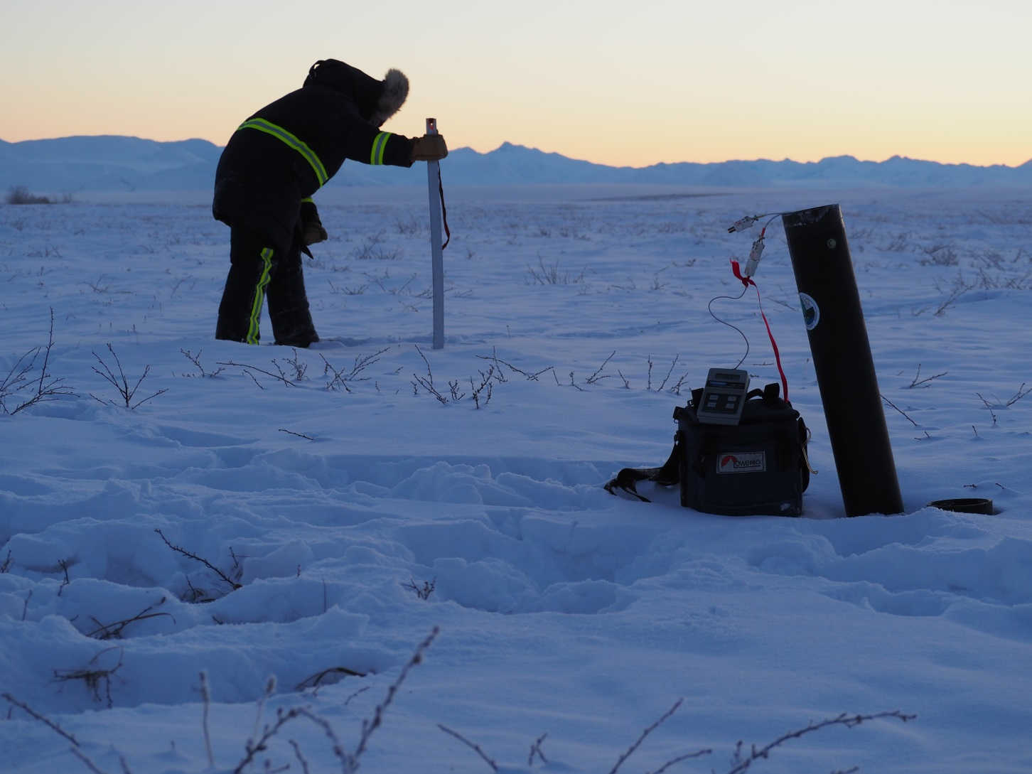
Coastal Areas: -5°C, 6 inches of snow
Foothills Areas: -5°C, 9 inches of snow

Slide 9
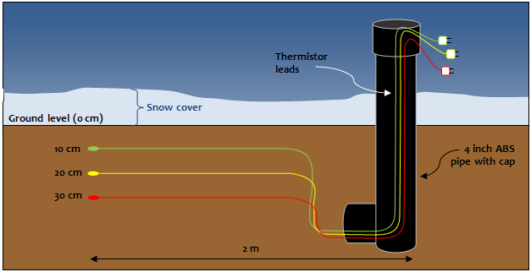

Slide 11
Increased pressure to open winter tundra travel earlier
Allows for a longer oil and gas exploration season
Increases the potential for tundra damage (i.e. scuffing, gouging, scraping)
Increased wildlife impacts
Increased fuel spill potential on the tundra

Slide 12
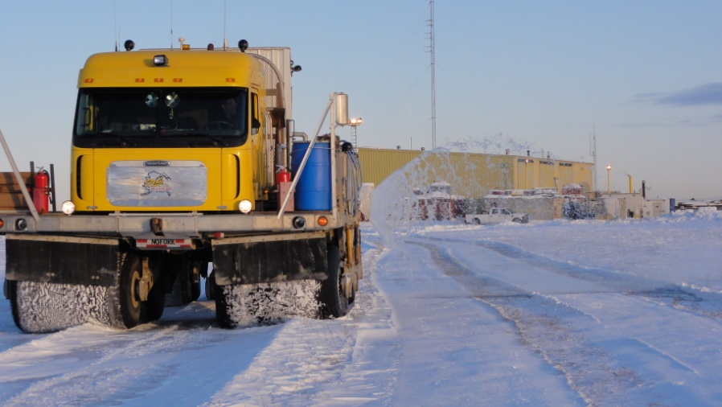
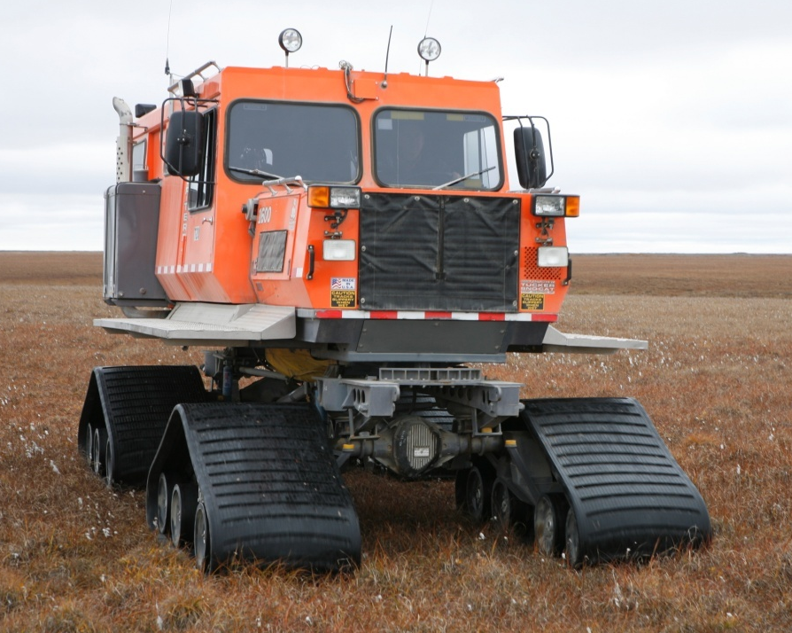
How have we extended the ice road season?
Utilize low-impact vehicles for initial pre-packing activities
Carefully choose routes based on vegetation and landforms that are more resistant to damage
Amendments of snow and/or ice chips
Evaluate new methods of ice road construction. (i.e. Rolligon water side-casting)
Rolligon
Tucker Sno-Cat

Slide 13
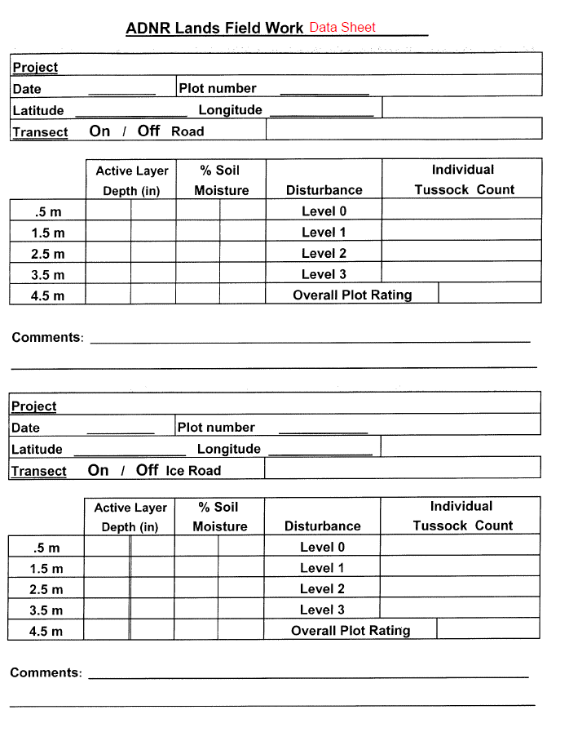
Ice/Snow Road Damage Assessments

Slide 14
Notes:
The Tussock Disturbance Indices for these two projects are shown on the right side of this chart. DNR’s goal is to have a disturbance index of 1.0 or less. The 2008/2009 Umiat Trail met this goal.

Slide 15
DMLW Management Guidelines
Continue to open tundra using snow depth criterion (6” in coastal, 9” in foothills) and soil temperature (-5° C).
For multiple pass projects:
  If SWE ≥ 3.0 inches, approve project.
  If SWE < 3.0 inches, approve project with increased DNR oversight.
DNR will continue to monitor snow conditions and impacts of off-road travel projects to determine the most appropriate management standards.
Notes:
Based on the comparison of the two Umiat Trails, DNR has modified its management guidelines for general off-road travel (particularly using skid-mounted sleighs). We will continue to open the tundra based on the snow depth criterion only.
However, we believe that snow water equivalent is a good tool that combines snow density and snow depth into a number that characterizes the ability of the snow to protect the tundra vegetation.
If the snow water equivalent is 3” or greater, DNR will approve the project and have similar oversight as what we use for normal projects. If the snow water equivalent is less than 3”, DNR will approve travel, provided that the permittee provide DNR with airline transportation, housing, and charter to monitor the project both during the winter and following summer.

Slide 16
Vehicle Testing for Summer Approved Use

Slide 17
Summer Approved Off-Road Travel Vehicles
Argo 8 I/C with smooth tracks.
Argo 6X6 Frontier 580 with Supertracks.
Argo 8X8 Avenger 750 HDi with Supertracks.
Roller-driven vehicles equipped with large, bag-type tires (ex. Rimpull)
Haggland Bearcat with smooth track configuration.
Tucker Snocat with smooth track configuration.
Tucker-Terra Sno-Cat model 1600 with smooth track configuration.
Tucker Terra 2000 with smooth track configuration.
Pisten Bully 100 Trail with smooth track configuration.
Pisten Bully 400 Trail with smooth track configuration.
Polaris Ranger 800 6X6 configuration with smooth tires (maximum payload, including passengers, is 1,200 lbs).
Polaris Ranger 800 6X6 with smooth tires and plastic smooth-bottom sled (maximum payload is 2,101 lbs in vehicle and 1,000 lbs in sled).
Kubota RTV900 with Litefoot tracks (payload, including passengers, must be under 500 lbs).
Kubota RTV1100 with LiteFoot tracks (payload, including passenger, must be under 1595 lbs).
Lindsey Snow Walker (used only during pre-packing operations).
Airboats (for use in spill drills,exercises, and responses only).

Slide 18
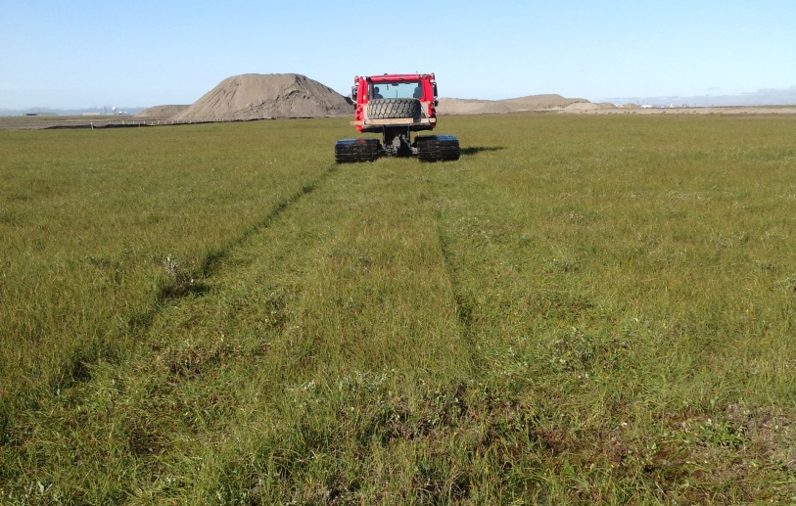
Disturbance or Damage?

Slide 19
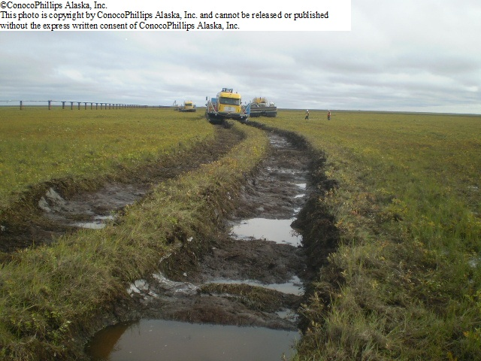
Disturbance or Damage?

Slide 20
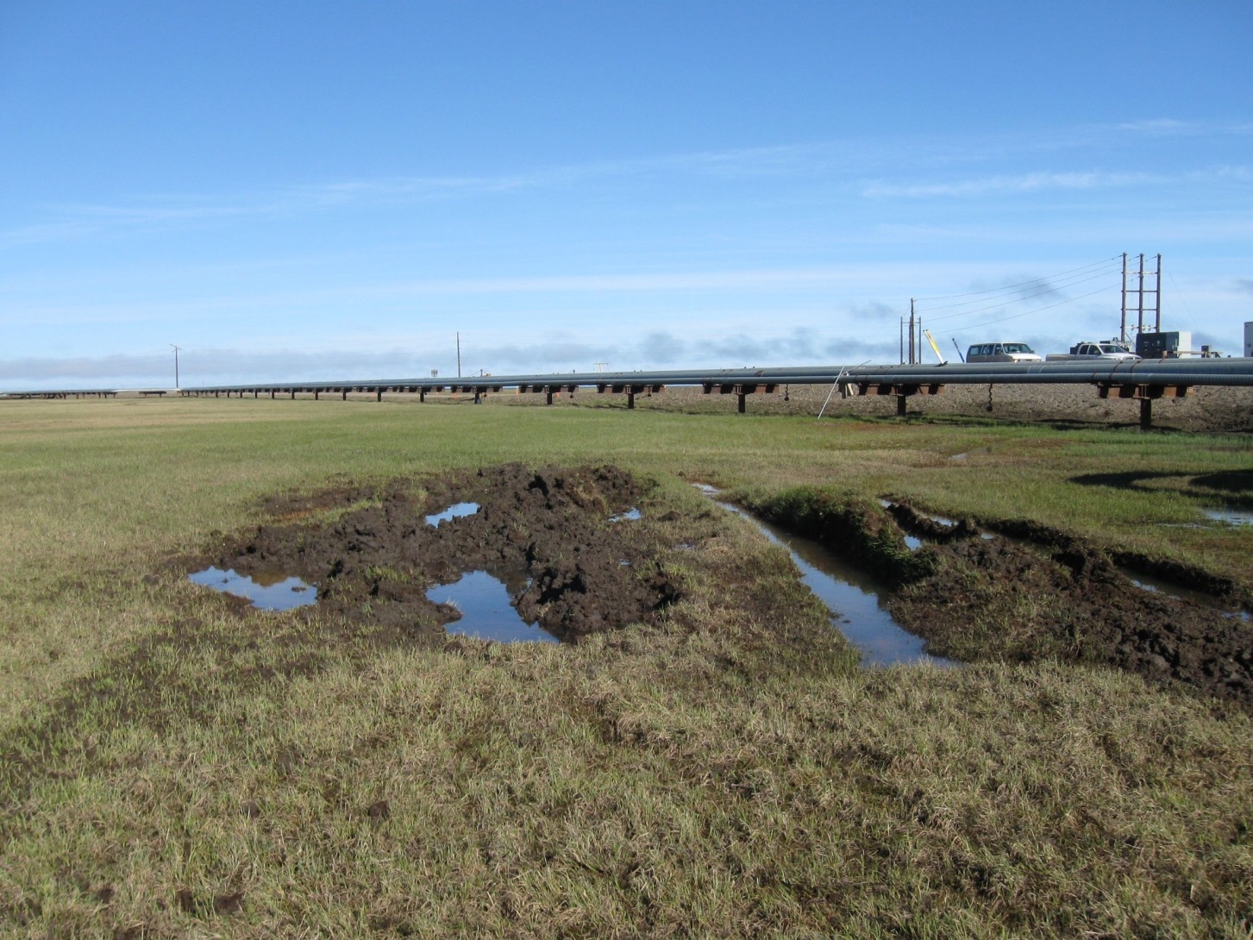
Isolated Disturbance or Damage?

Slide 21
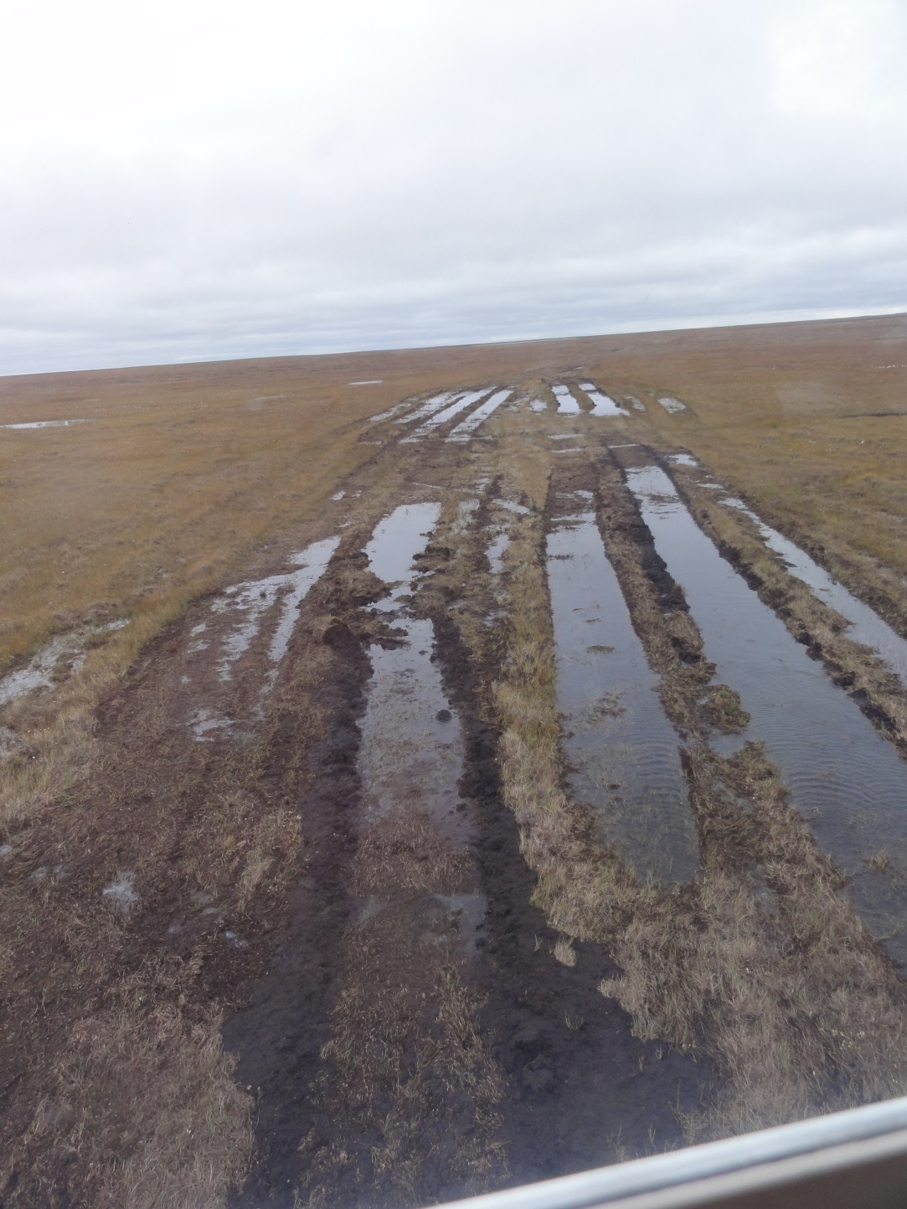
Extensive Disturbance or Damage?

Slide 22
Rehabilitation
If tundra damage is diagnosed, a rehabilitation plan must be prepared and executed by the damaging party
Periodic site inspections conducted
Closure of a tundra damage incident will be indicated by sign–off from the authorized officer

Slide 23
Treatment Options
Tundra sodding
Seeding
Fertilizing
Moving dislodged vegetation back in place
Compressing areas that have been pushed up
Raking away dead vegetation
Tundra plugs

Slide 24
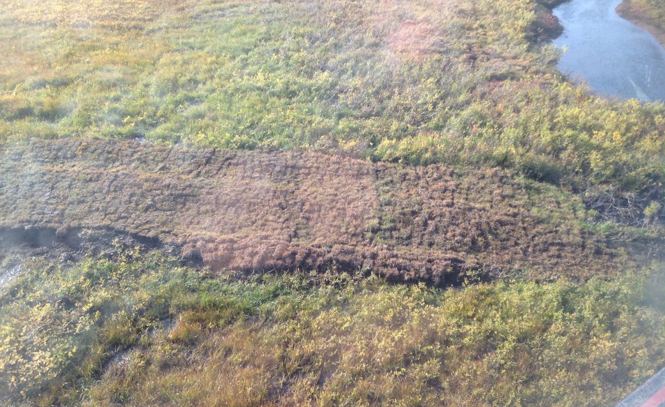
CPAI Rolligon Damage Rehab

Slide 25
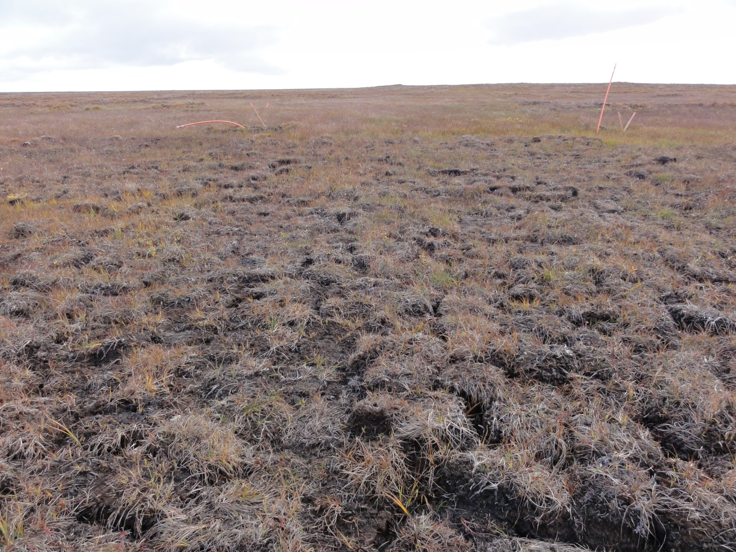

Slide 26
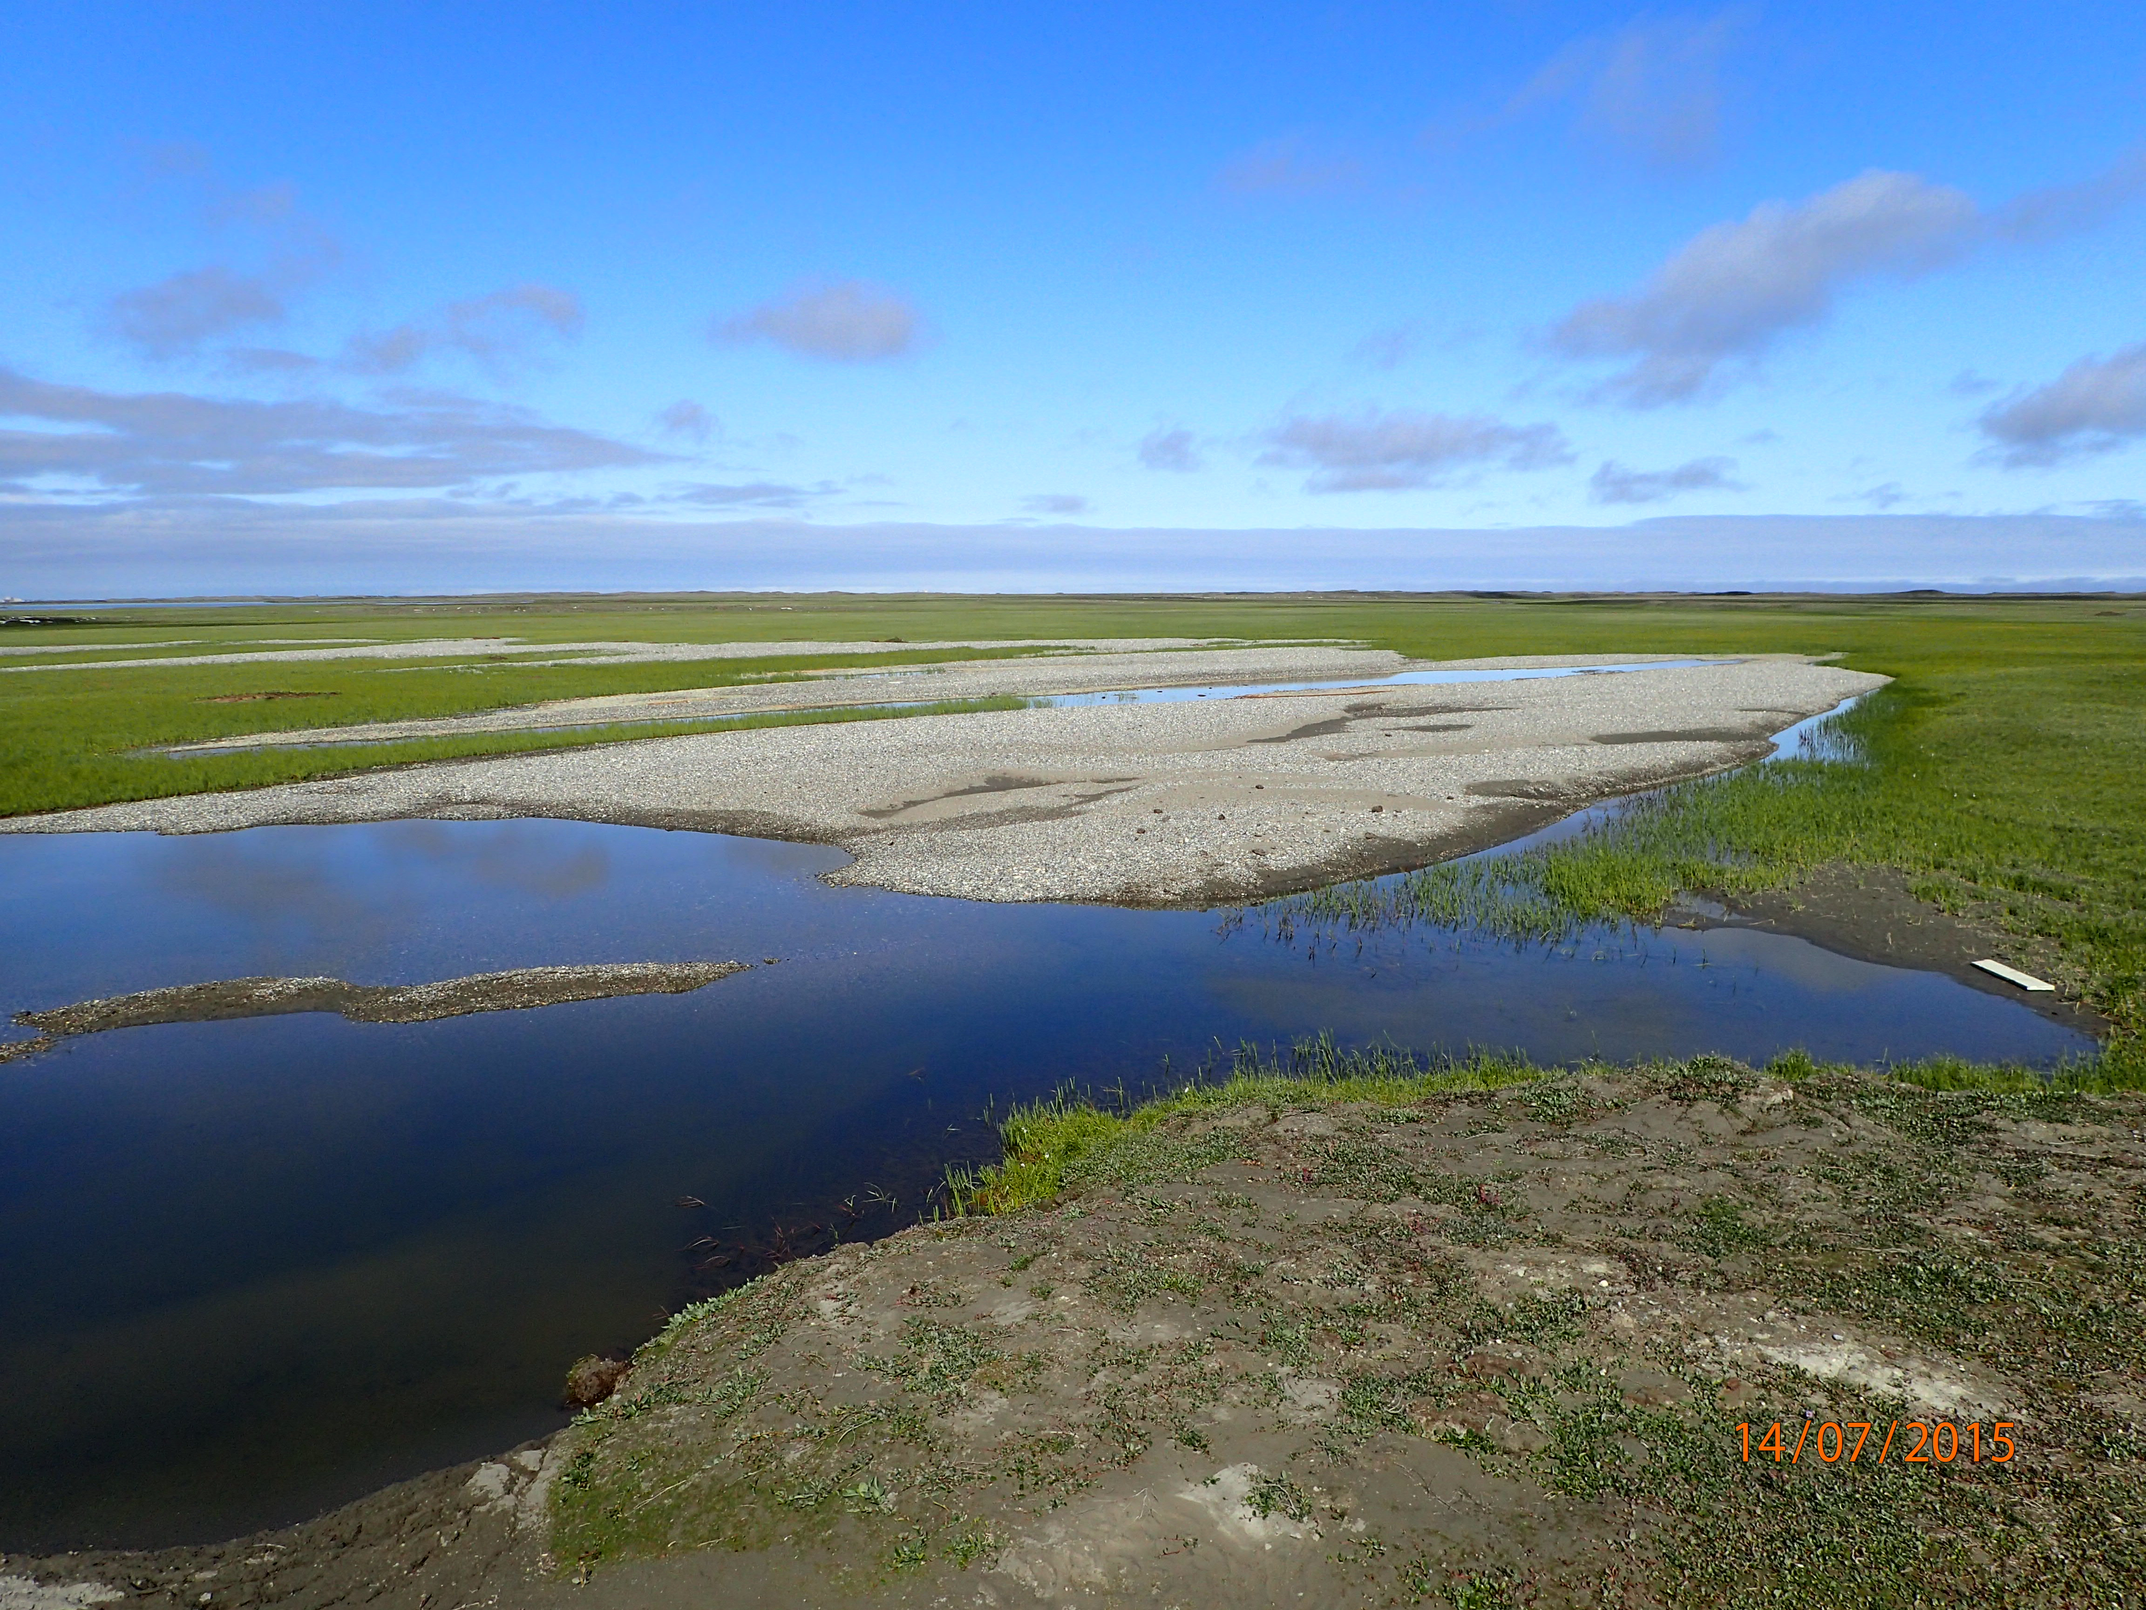
Questions?

